Slide 1
pdap 2025 Joint Conference Meeting
Sara Jacobson
Executive Director

Slide 2
Agenda
PDAP update
Indigent Defense Advisory Committee update & discussion
Vote on Financials & Budget
Discussion re adding a 501(c)3 to our 501(c)6

Slide 3
Welcome + who’s here?
PDAP Jt. Conference Meeting April 2025

Slide 4
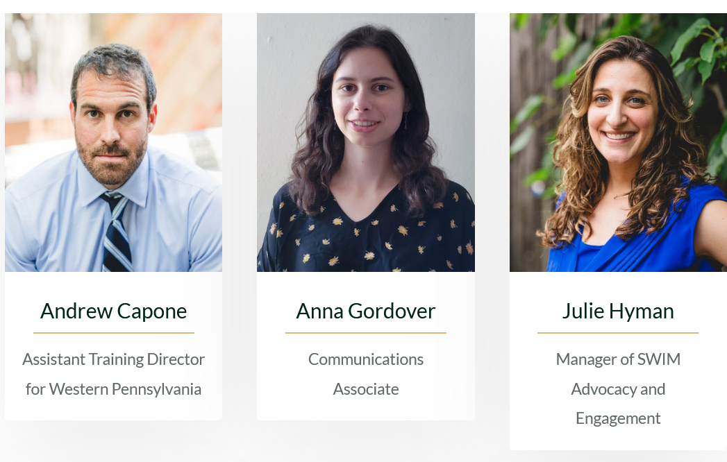
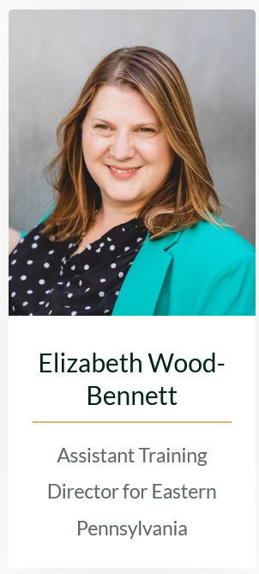
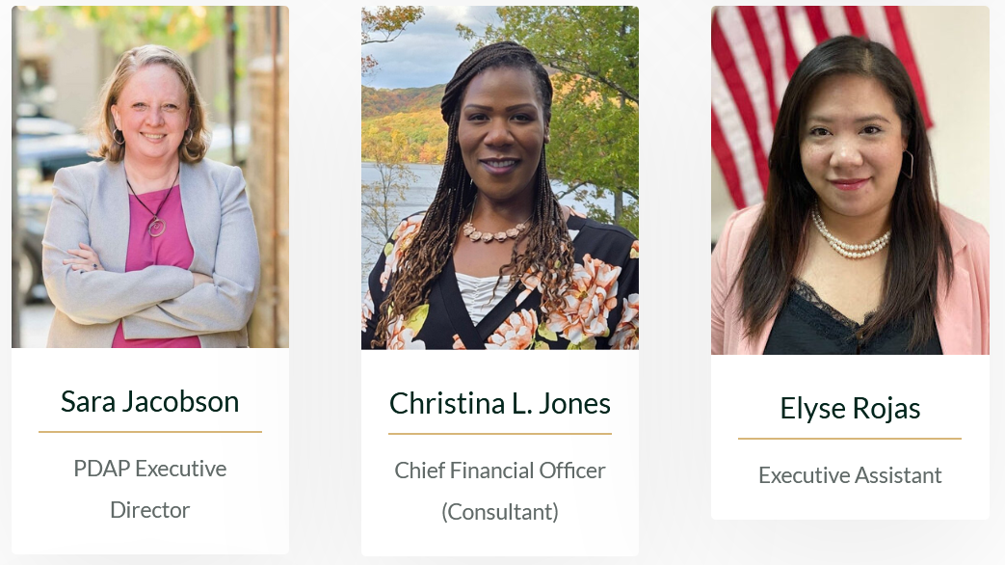
Our Team
Western PA Asst. Training Director: Andrew Capone
Comms. Associate: Anna Gordover
Manager of SWIM Advocacy & Engagement: Julie Hyman
CFO: Christina Jones
Executive Asst.: Elyse Rojas
Eastern PA Asst. Training Director: Elizabeth Wood-Bennett

Slide 5
Trainings in 2024
40 online trainings
17 in-person conferences
+1850 people reached
Emerging Leaders Program
External scholarships for 42
NEW: Racial Justice + Forensic Series

Slide 6
Emerging Leaders in 2025
16 participants (Allegheny, Blair, Bucks, Cambria, Dauphin, Delco, Lehigh, Monroe, Philly, Schuylkill, York)
4 in-person conferences
Monthly meetups
Mentorship
Scholarships to Excelling in Evidence

Slide 7
Online Options
Preliminary Hearing Course
(coming soon: Pretrial Motions)
LinkedIn: https://www.linkedin.com/company/public-defender-association-of-pennsylvania-pdap/
Private Instagram: https://www.instagram.com/papublicdefenders/
Listservs serving 850+ people across 6 lists
Updated Website: https://papublicdefenders.com/

Slide 8
SWIM Projects & Numbers
Investigators
32 31 Counties
Social Services
20 16 Counties
1) How to Fund a SW 2) New SW/SSA 3) New Investigators 4) MH + IDD Manuals
Meetups & Trainings

Slide 9
Other supports
CLEAR Investigative software
Appellate Mooting Board
PDAP/Pitt PD Hiring Day February
Cellebrite Technology
Mooting Appeals

Slide 10
Policy & Legislative Work
Multiple Senate & House Bills
Feedback on proposed new Criminal Procedure Rules
7 Public Defenders on the IDAC
Testimony & Media re indigent defense funding
Feedback to Decisionmakers

Slide 11
Policy & Legislative Work
Multiple Senate & House Bills
Feedback on proposed new Criminal Procedure Rules
7 Public Defenders on the IDAC
Testimony & Media re indigent defense funding
JOIN THE POLICY COMMITTEE
Feedback to Decisionmakers

Slide 12
Indigent Defense Advisory Committee (IDAC)
1st $7.5 million appropriation + 2nd $7.5 million approp.
Three subcommittees: Data, Standards, & Training
7 Members are Public Defenders: Julie Burke (Blair), Sam Encarnacion (Lancaster), Autumn Johnson (Mercer), Christine Lora (Montco), Kate Parker (Philly), Ted Skaarup (Northampton), Cheryl Sobeski-Reedy (Luzerne),
3 members are former PDs: Sara Jacobson (Chair), Kate Cacciamani (Vice-Chair), Leigh Skipper

Slide 13
IDAC: Two Initial Standards
Funding, Structure, & Oversight
Essential Components of Effective Representation
See ABA Ten Principles #2 & #9
Working on Training Standard now

Slide 14
What’s Next?

Slide 15
Finances
2024 Finances & 2025 Budget
Where we stand re adding a 501(c)3 to our existing (c)6

Slide 16
Comparison
501(c)6
501(c)3
What we have now -> nonprofit association
Permits more freedom to lobby for policy changes
Fundraising limitations
Non-profit corporation formed to carry out a charitable, religious, literary, educational or scientific purpose that is recognized by the Internal Revenue Service as tax exempt.
Lobbying limitations
Can raise funds from private funders

Slide 17
Timeline
Board discusses & votes
Draft bylaws & propose to board for feedback
File for determination
3-6 months for determination letter
Find pro-bono counsel

Slide 18
My Ask for Your Help

Slide 19
Questions?

Slide 20
pdap 2025 Joint Conference Meeting
Sara Jacobson
Executive Director

