Slide 1
Indigent Defense
Advisory Committee &
Grant fund
Overview

Slide 2
Brief history
Until 2023, PA did not provide funding for its Defenders
Act 34 of 2023 created the IDAC + Grant Fund within PCCD
Lots of People worked toward this

Slide 3
Brief history
Lots of People worked toward this
Sen. Greenleaf, Phyllis Subin, Mimi McCormick, Al Flora
Speaker McClinton, Rep. Nelson, Sen. Baker, Sen. Hughes

Slide 4

What PDs are on the IDAC

Slide 5
What PDs are on the IDAC
Julie Burke
Sam Encarnacion
Autumn Johnson
Christine Lora
Kate Parker
Ted Skarrup
Cheryl Sobeski-Reedy
Chair: Sara Jacobson

Slide 6

Who gets funding?
EVERY COUNTY IS ELIGIBLE

Slide 7
What is funding for?
INDIGENT DEFENSE-> SO NOT JUST PD OFFICES

Slide 8
IMPORTANT DATES
The applications are open now
Recommended eGrants registration date = 5/9
Submit applications by 5/23
18 month projects, running from 7/1/24 through 12/31/ 25

Slide 9
Eligible to fund
(seE FUNDING FRAMEWORK FOR DETAILS)
a. Salaries and benefits for FT & PT staff
b. Recruitment, promotion, retention (including bonuses)
c. Data collection like case management
d. Training & professional development
e. Obtaining technical assistance
f. Travel
g. Supplies & equipment
h. Any other costs associated with gaps or needs identified by the county in consultation with those providing indigent defense services

Slide 10
faq
The COUNTY is the applicant & must sign off on it
Do not need CJAB approval
Not every data point must be filled in to apply
There will be reporting requirements

Slide 11

How do I…?
Apply: First register with PCCD eGrants
Register for eGrants: Google “PCCD eGrants” or https://prdpccd.pwpca.pa.gov/Funding/Pages/Egrants-Home.aspx
Egrants system, call the Help Desk at (717) 787-5887 or toll-free at (800) 692-7292

Slide 12
How do I…?
Learn about other grant opportunities: watch the listserv + sign up to get PCCD grant alerts: https://egrants.pccd.pa.gov/public/Subscribe.aspx
Find the standards & funding framework: Google “PCCD IDAC” or https://prdpccd.pwpca.pa.gov/AboutUs/Pages/Indigent-Defense-Advisory-Committee.aspx

Slide 13
To LEARN more
Upcoming PDAP Chief Meetups on funding
  5/9 at 3:30 – with PCCD staff
  5/16 3:30 – PDs only
PCCD webinar Tuesday 5/14 from 3-4pm: https://forms.office.com/pages/responsepage.aspx?id=QSiOQSgB1U2bbEf8Wpob3mA76dMWfuFMql0TyG9qAC5UNEQ1NkJZUkE2NUhFNjNOUjU4Rk5DWU9OUy4u

Slide 14
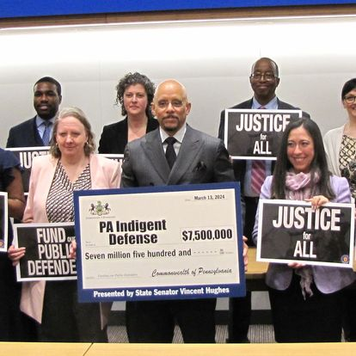
Will there be more Money?
We sure hope so

Slide 15
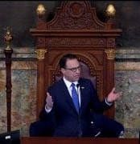
Will there be more Money?
Harrisburg, PA — Today, less than one week after Governor Josh Shapiro proposed $10 million for indigent defense to be funded through the Pennsylvania Commission on Crime and Delinquency (PCCD) in his 2024-25 budget proposal, PCCD’s Indigent Defense Advisory Committee held its inaugural meeting to begin developing statewide standards and a statewide funding system for indigent defense services, which provide legal representation for those who cannot afford it on their own.
-2/24/24 Shapiro Press Release

Slide 16
Indigent Defense
Advisory Committee &
Grant fund chiefs’ forum discussion

